Slide 1
Peer To Peer Video Chat
Deepak T S
Gaomeizhu Qu
Sijia Zhang
Dec.12th 2016
GitHub
Trello
Notes:
1
Good evening, we are the video chat team and now is our sprint 3 presentation. In sprint 2, we built database for our project and connected it to the login program. Also we have a program for video chat.

Slide 2
Product Highlights
Our app enables users to communicate using video call.
WebRTC technology was used, as it is an upcoming field which provides connection quality.
We were able to send 2 video streams through 1 call.

Slide 3
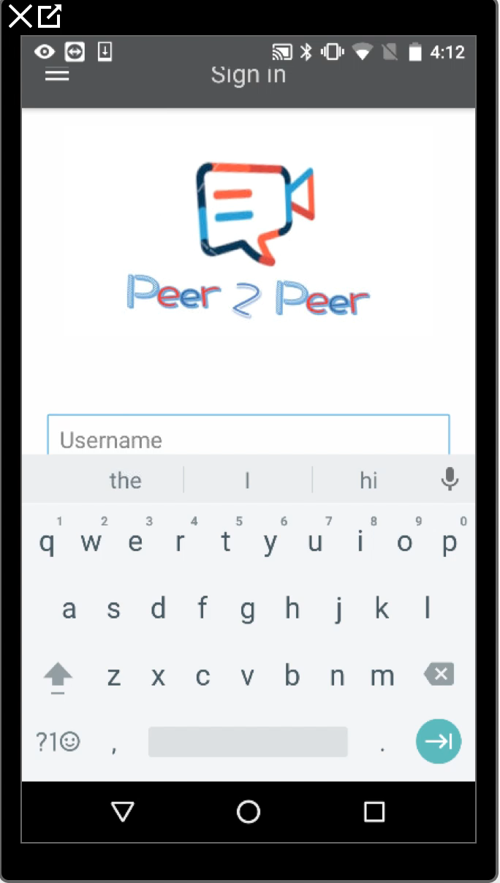
Demonstration

Slide 4
Test results
Pass:
Use correct information to sign up
Use username and password to sign in
Jump from sign in page to video chat page
Create a room and add it to the favorite list
Set preference in setting
Fail:
User uses a wrong email address or an email address that already exists to sign up
clicks the button to begin a video chat
Not run:
Invite the third people to the room
The microphone button ,the stop the video call button
The dual camera button

Slide 5
Lessons Learned
Top three things that worked well:
Database creation for users
Combining Login app with the Video chat app
Sending 2 video streams through WebRTC
Top three things that you have learned:
Database creation
Android Programming
WebRTC technology

Slide 6
Lessons Learned
Top three things that did not go well:
Capturing videos from 2 different cameras on the same device was not possible.
Even if capturing was possible, not sure whether they could have been recorded.
Unable to implement inviting friends.
One thing you as a team will do differently in the future:
Make effecient use of GitHub to work individually without having the need to meet regularly.
Any future plans for your project:
Try to implement dual camera feature on devices which have the hardware capability to support the function

Slide 7
Use cases developed:
Video Chat app enables user to connect to each other on a video call, using WebRTC technology.
Users : Common people
Technologies Used:
WebRTC technology for establishing connection between 2 clients
Android Studio for Android App development
Amazon Cognito for User management

Slide 8
System architecture
Phone number Verification
User 1
User 2
Sign in successfully
Account Creation
Account Creation
Video Chat
Media Stream
AWS Cognito Database
AWS Cognito Database
Video Stream 1
Video Stream 2
Audio Stream

Slide 9
Thank You

